Slide 1
Module:3-AWS Networking and Content Delivery
Amazon VPC (Virtual Private Cloud),
VPC Subnets,
Route Tables,
Security Groups,
VPC Peering,
AWS Direct Connect, AWS Networking and Content Delivery
Amazon CloudFront

Slide 2
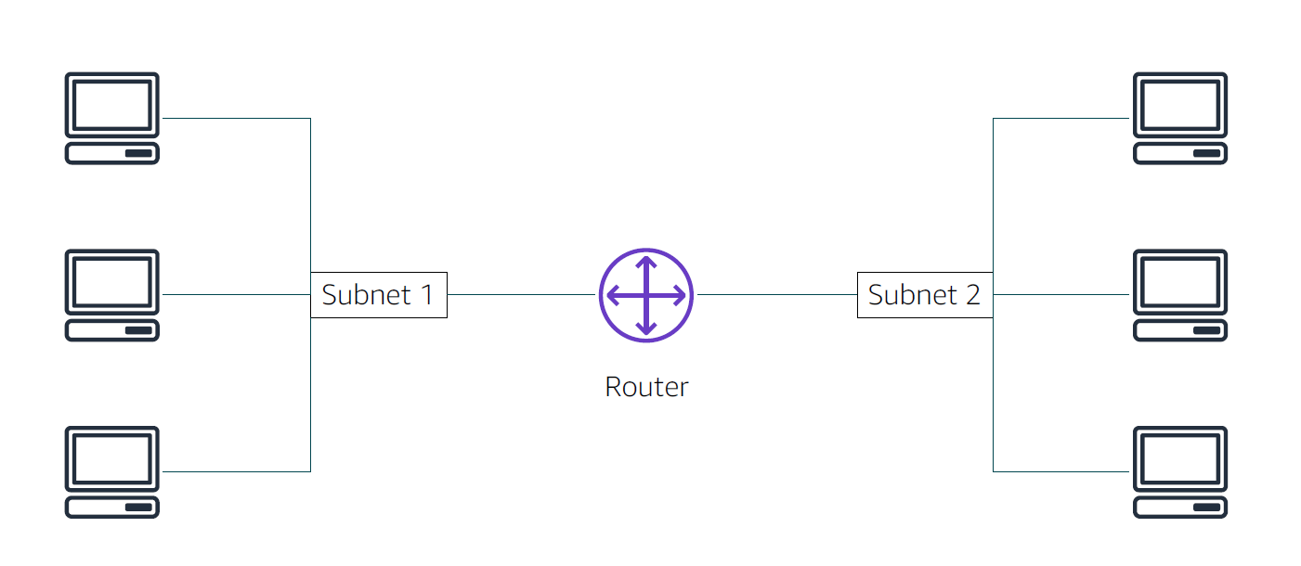

Slide 3
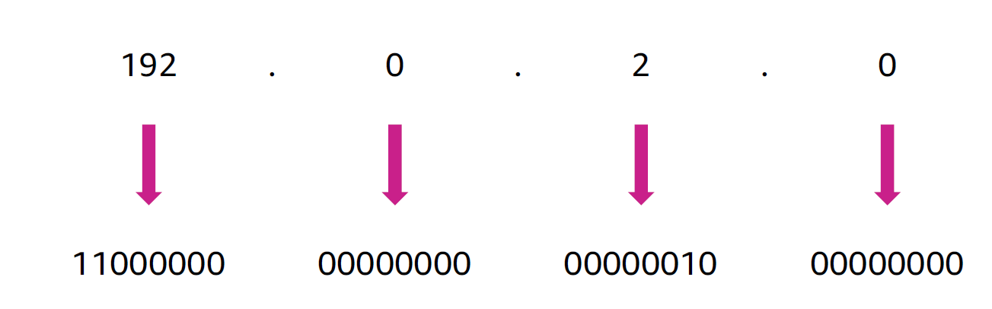
IP addresses

Slide 4
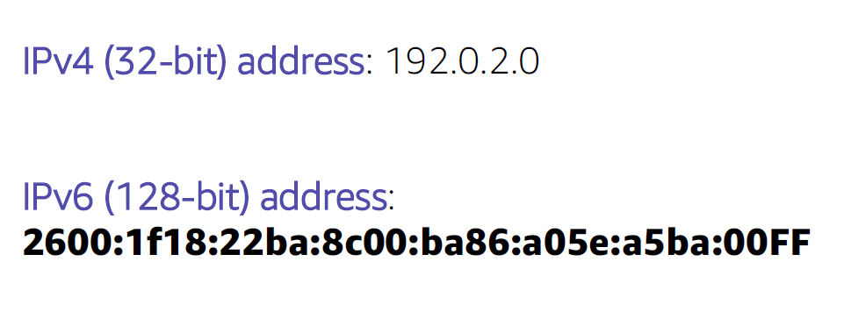
IPv4 and IPv6 addresses

Slide 5
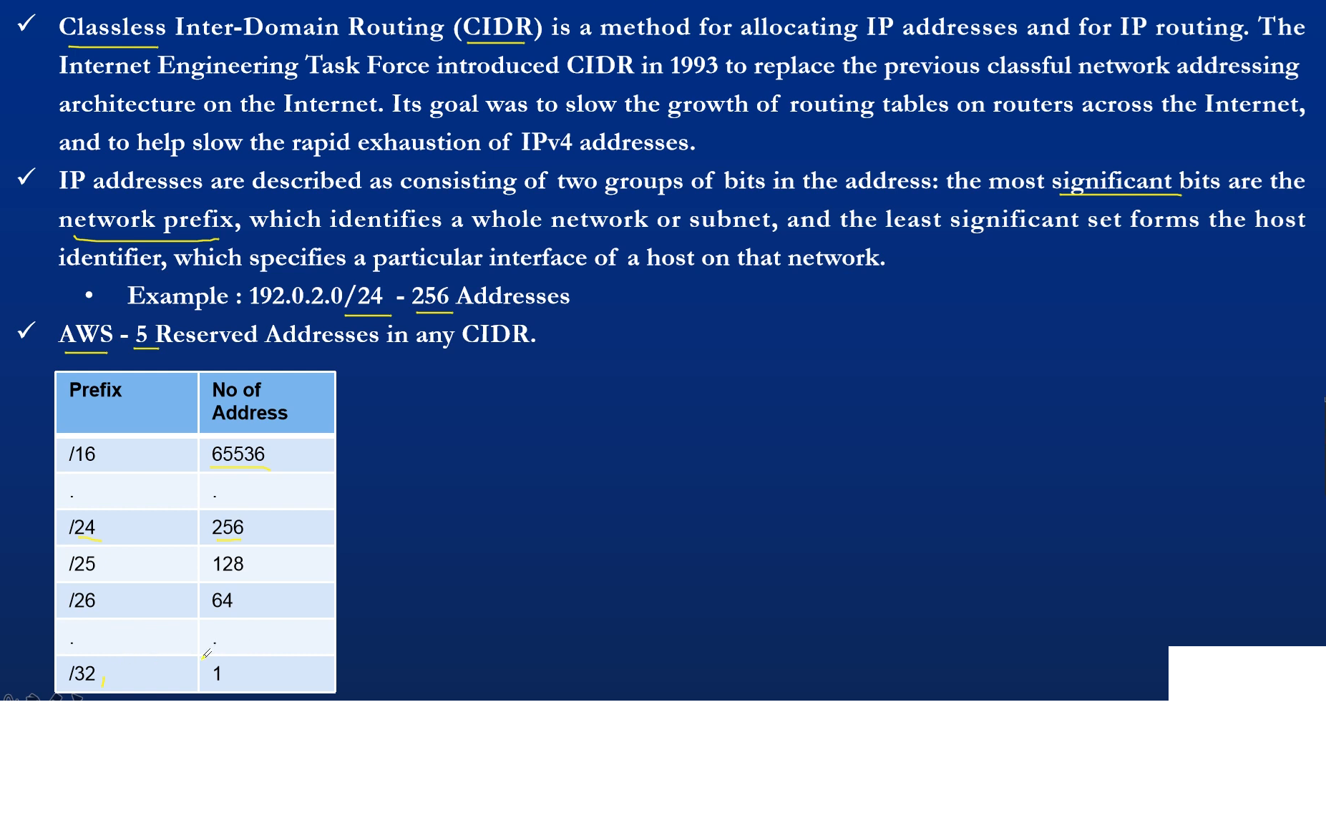

Slide 6
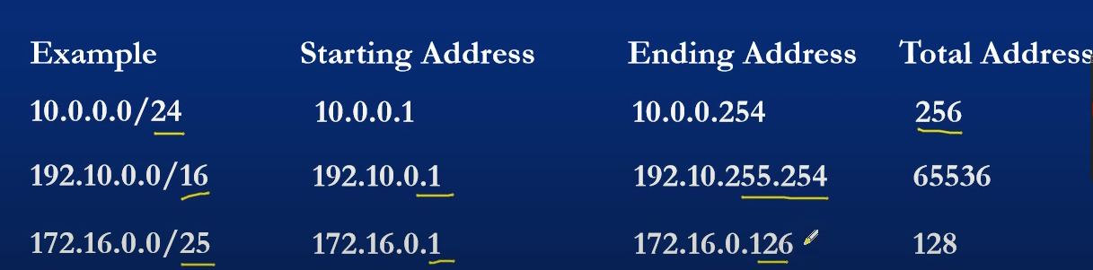

Slide 7
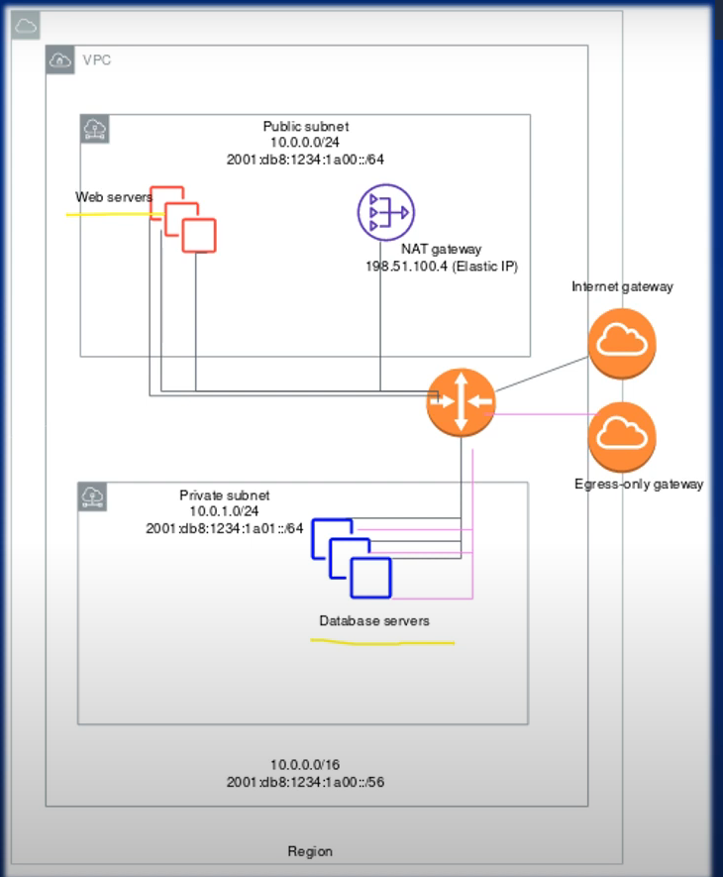

Slide 8
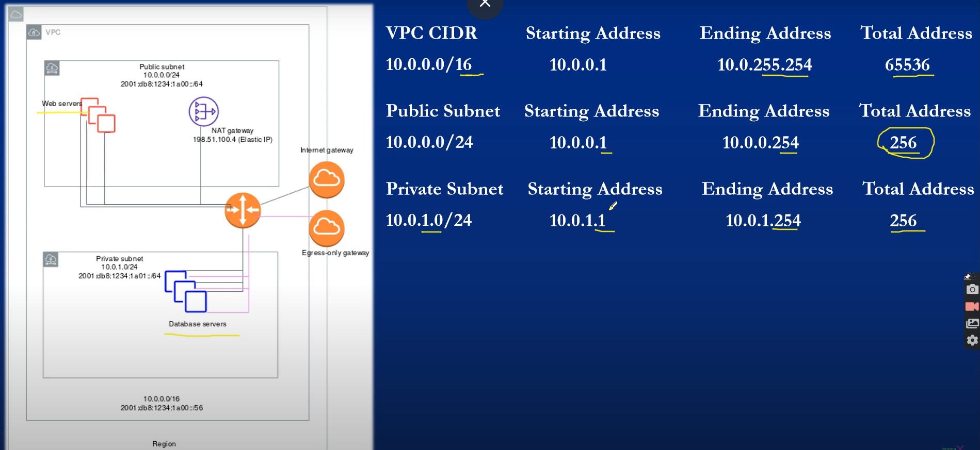

Slide 9
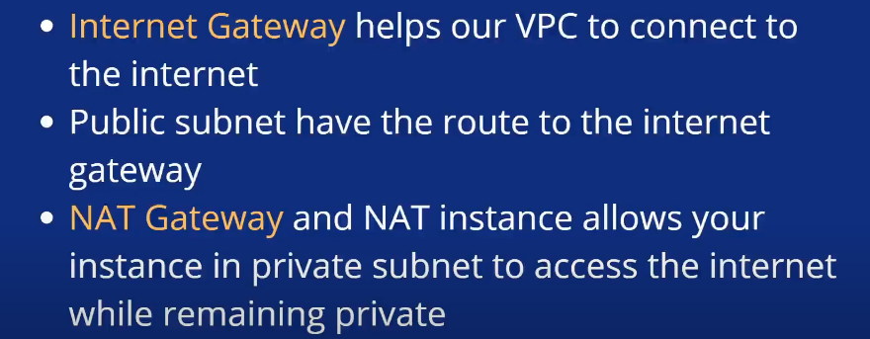

Slide 10
Amazon VPC
Enables you to provision a logically isolated section of the
AWS Cloud where you can launch AWS resources in a virtual
network that you define
Gives you control over your virtual networking resources,
including:
Selection of IP address range
Creation of subnets
Configuration of route tables and network gateways
• Enables you to customize the network configuration for your
VPC
• Enables you to use multiple layers of security

Slide 11
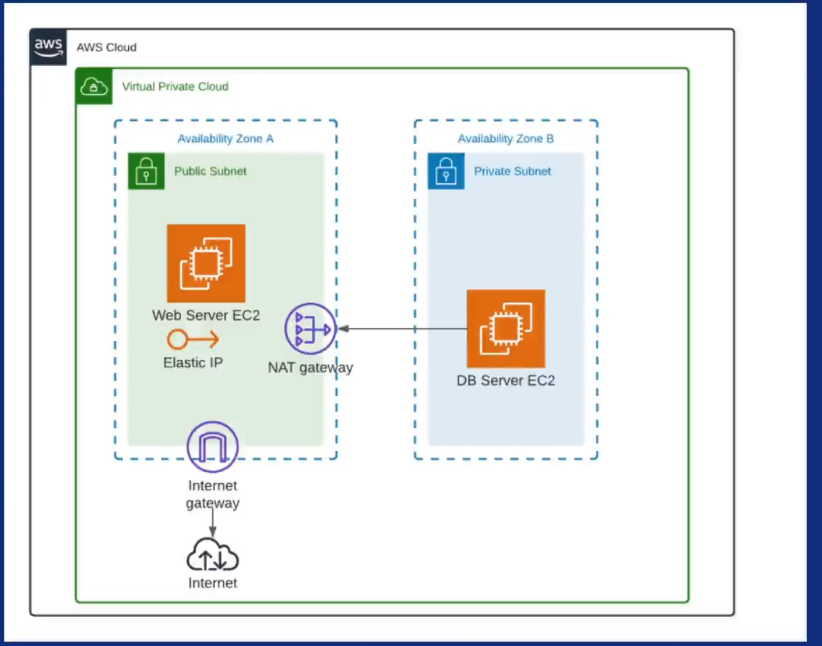
Amazon VPC

Slide 12
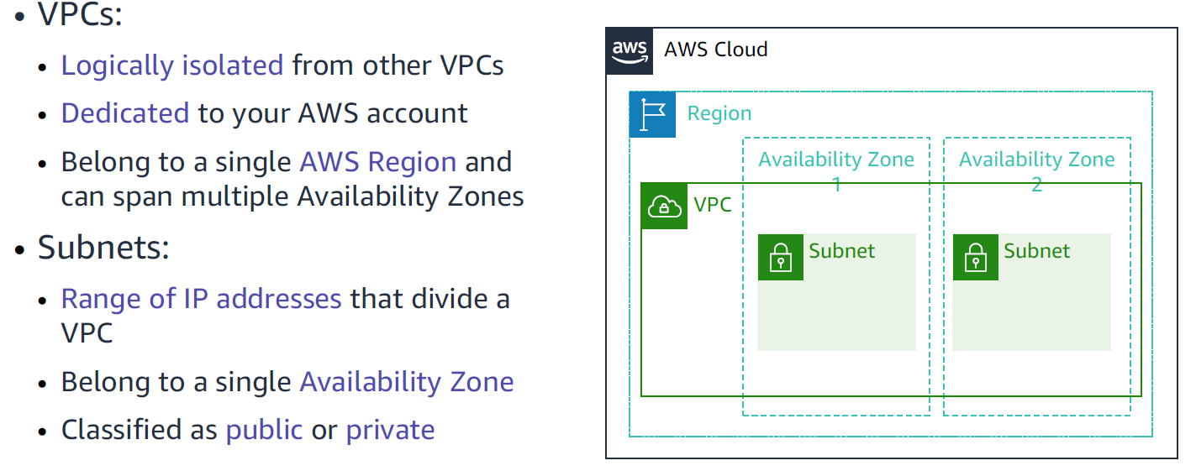
VPCs and subnets

Slide 13
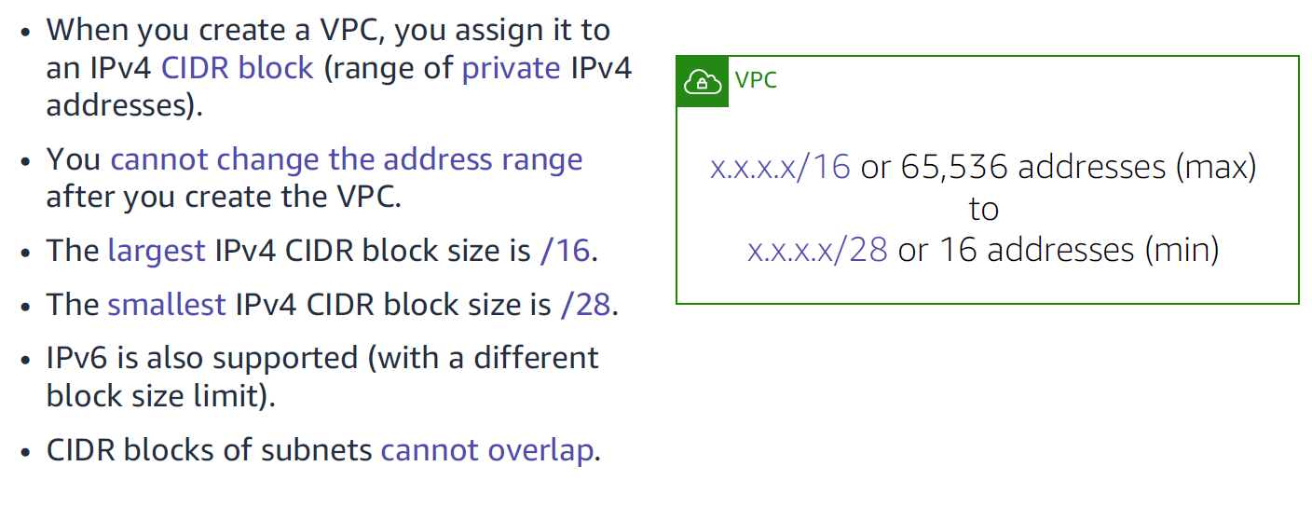
IP addressing

Slide 14
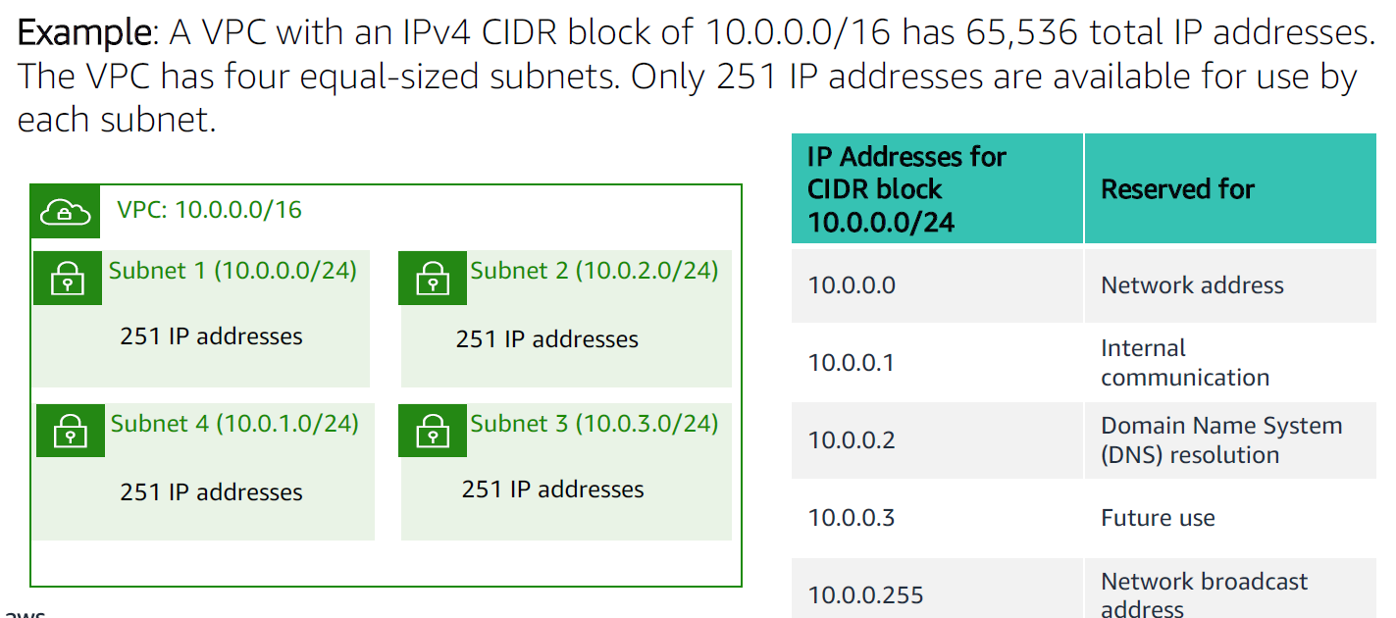
Reserved IP addresses

Slide 15
Public IPv4 addresses are automatically assigned to instances when launched and can change when the instance is stopped and restarted.
Elastic IPs, on the other hand, are static public IPv4 addresses that you can allocate to your account and associate with instances, allowing you to maintain a consistent IP address even if the instance is stopped and restarted.

Slide 16
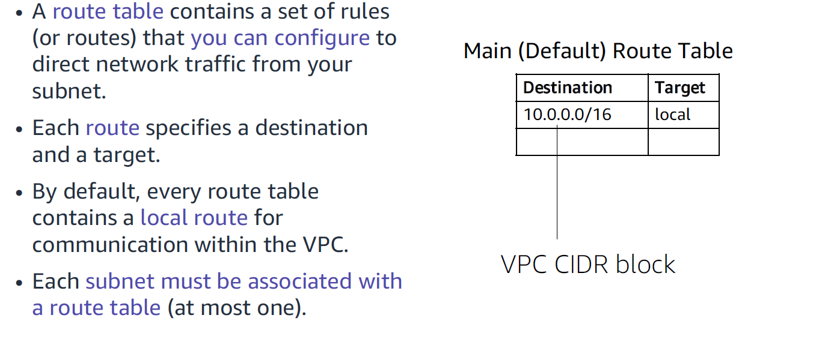
Route tables and routes

Slide 17
Security Group
A security group is a virtual firewall which is controlling the traffic to your EC2 instances.
When you first launch an EC2 instance, you can associate it with one or more security groups.
A Security group is the first defence against hackers.

Slide 18

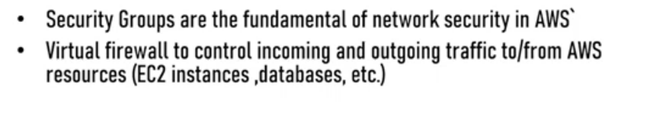

Slide 19
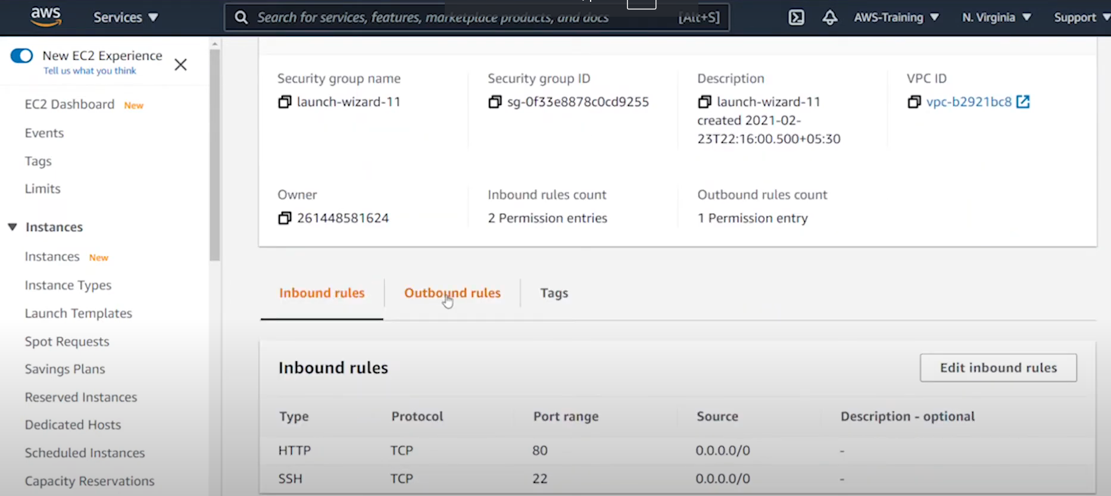

Slide 20
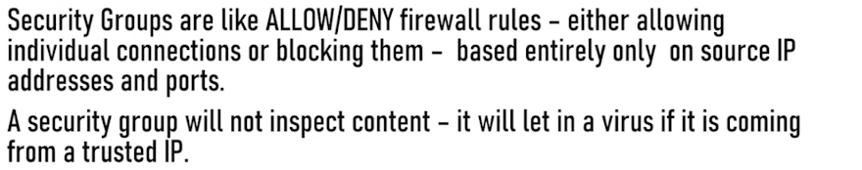

Slide 21
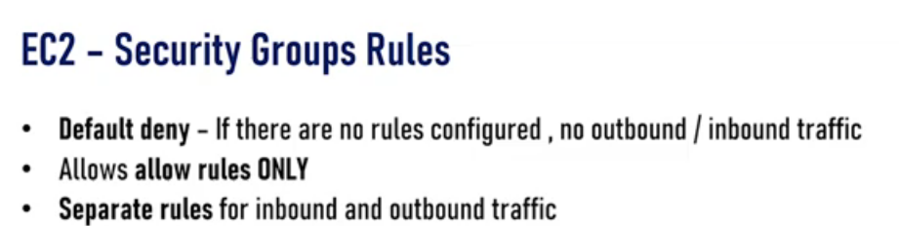

Slide 22
VPC Peering
VPC Peering is a networking connection between two Virtual Private Clouds (VPCs) in AWS that allows them to communicate with each other privately as if they were within the same network, without using public internet or VPNs.

Slide 23
A virtual private cloud (VPC) is a virtual network dedicated to your AWS account.
It is logically isolated from other virtual networks in the AWS Cloud.
You can launch AWS resources, such as Amazon EC2 instances, into your VPC.

Slide 24
A VPC peering connection is a networking connection between two VPCs that enables you to route traffic between them using private IPv4 addresses or IPv6 addresses.
Instances in either VPC can communicate with each other as if they are within the same network.

Slide 25
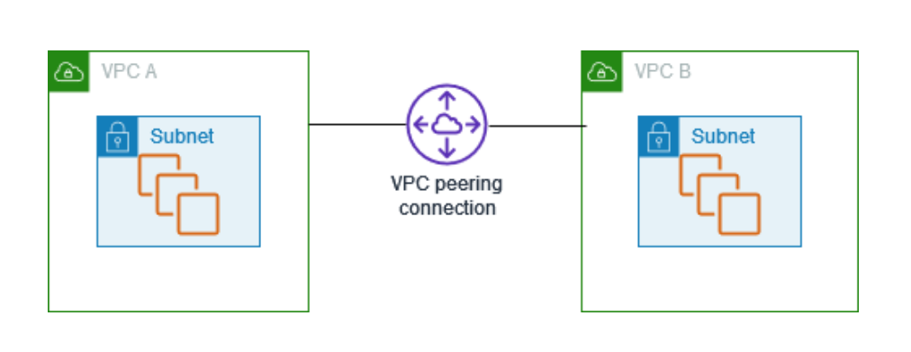
VPC Peering

Slide 26
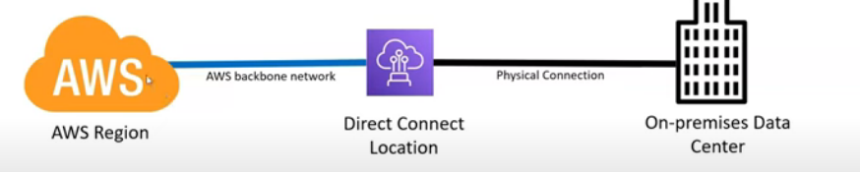
AWS Direct Connect
AWS Direct Connect is a cloud service that enables you to establish a dedicated, private network connection from your on-premises data center to AWS, bypassing the public internet for improved bandwidth, lower latency, and enhanced security.

Slide 27
Real-Time ExampleThink of AWS Direct Connect as a private, high-speed express lane directly from your office to a cloud data center, ensuring faster, more secure, and reliable access to your cloud resources, without the delays and variability of public roads (the internet).

Slide 28
Amazon CloudFront
Amazon CloudFront is a fast content delivery network (CDN) service that securely delivers data, videos, applications, and APIs to customers globally with low latency, high transfer speeds, all within a developer-friendly environment.
Securely deliver content with low latency and high transfer speeds

Slide 29
Benefits
Fast and global
Security at the Edge

Slide 30
Example
Imagine you have a popular website with users all over the world. Amazon CloudFront is like setting up local warehouses (edge servers) near your users, so when they request content from your site, they get it quickly from the nearest warehouse instead of waiting for it to come all the way from your main headquarters (the origin server).

